Slide 1
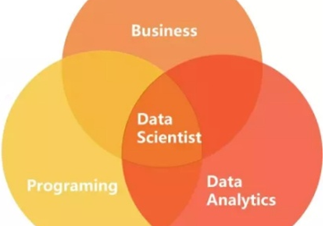
Statistical knowledge tutorial
[DRAFT]
Statistical tutorial| 2018-09-26

Slide 2
Among the data analysis journey, different analysis tools are adopted for specific analysis objects
Analysis process road map
Road map for data analysis
YES
Descriptive statistics
Diagnostic analysis
Large sample or population?
Verify assumption?
YES
Hypothesis test
NO
YES
Correlation analysis
Relationship analysis
Linked
Collect data, formalize and cleanse dataset
Linear relationship?
Association analysis
Linked
NO
Have explanatory variable?
YES
Linear Regression
Predictive analysis
NO
Time series analysis
Predict a category?
NO
Have labeled data?
NO
Exploratory analysis
Clustering
YES
Classification
YES
Linked
Source: Advancy analysis

Slide 3
Agenda
DIAGNOSTIC ANALYSIS
DESCRIPTIVE STATISTICS
HYPOTHESIS TEST
RELATIONSHIP ANALYSIS
EXPLORATORY ANALYSIS
PREDICTIVE ANALYSIS
Sephora case study
KEY TIPS FOR DATA ANALYSIS
Appendix
Source: Advancy analysis

Slide 4
Agenda
DIAGNOSTIC ANALYSIS
DESCRIPTIVE STATISTICS
HYPOTHESIS TEST
RELATIONSHIP ANALYSIS
EXPLORATORY ANALYSIS
PREDICTIVE ANALYSIS
Sephora case study
KEY TIPS FOR DATA ANALYSIS
Appendix
Source: Advancy analysis

Slide 5
Descriptive statistics is a summary statistic that quantitatively describes or summarizes features of a collection of information
Diagnostic data analysis – descriptive data analysis
Data concentration measure
Data DISPERSION MEASURE
Averages in statistical
Mean
the sum of all the numbers divided by the number of data
Median
the value of the middle term when data are arranged
Mode
the most frequent numbers that occur in the set of data
Mean is the most common but easily effected by outlier
Dispersion in statistical
Standard deviation
Range
Interquartile range(IQR)
equal to the difference between 75th and 25th percentiles
MD(mean deviation), MAD(median absolute deviation), Gini(mean absolute difference), etc.
statistical dispersion measure is zero if data are the same and increases as the data become more diverse
Data distribution
Statistical graph
Normal distribution
Commonly used in the natural and social sciences
Skewness: tells you departure from horizontal symmetry
Positive skewness: mean>mode>median
Negative skewness: mean<mode<median
Zero skewness: symmetric
Kurtosis: tells you how tall and sharp the central peak is
Bar chart: show comparisons among discrete categories
Histograms: used for continuous data, where the bins represent ranges of data
Line chart: show tendency
Scatterplots(bubble chart): show correlation with two(three) dimensions
Pie chart: show percentage
Box plots: show outliers
Source: Advancy analysis

Slide 6
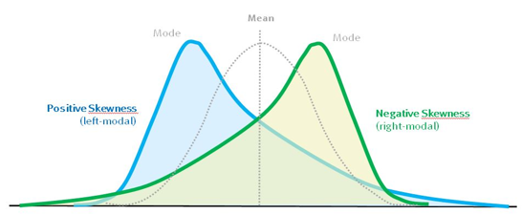
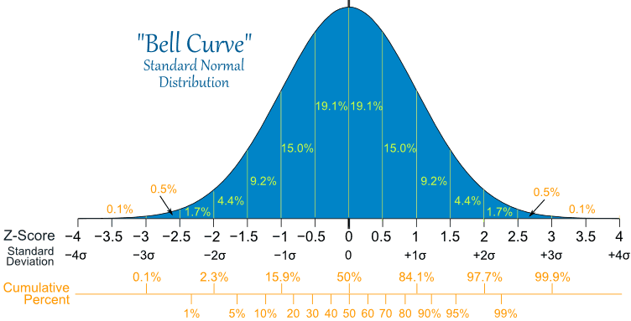
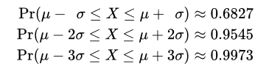
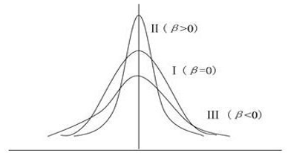
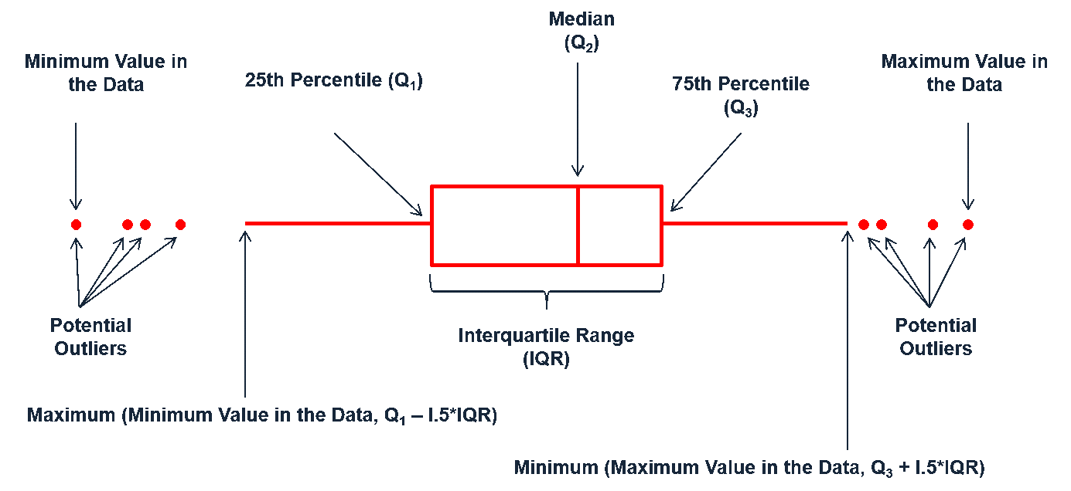
Data visualization for descriptive data analysis can help to better understand the distribution of the data
Descriptive data analysis – examples
skewness
Normal distribution
KurTOSIS
Box plot
Normal distribution
Source: Advancy analysis

Slide 7
Agenda
DIAGNOSTIC ANALYSIS
DESCRIPTIVE STATISTICS
HYPOTHESIS TEST
RELATIONSHIP ANALYSIS
EXPLORATORY ANALYSIS
PREDICTIVE ANALYSIS
Sephora case study
KEY TIPS FOR DATA ANALYSIS
Appendix
Source: Advancy analysis

Slide 8
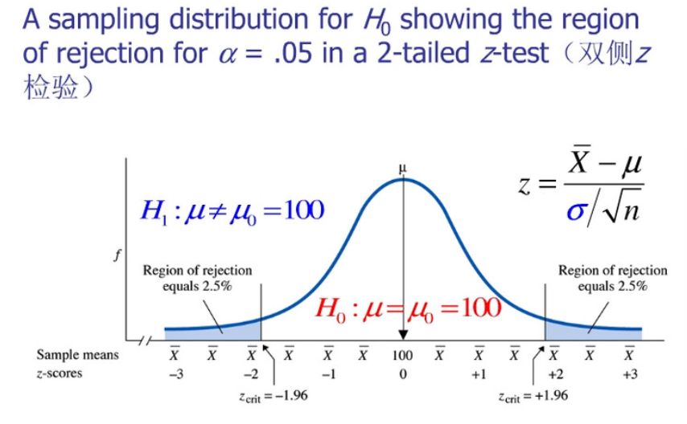
Hypothesis test allows one to interpret whether the assumption holds or has been violated
Diagnostic data analysis – hypothesis test
Hypothesis test
T-TEST
One-sample test:
One person’s height is equal to national average
Two independent-sample test:（From two population）
Men’s income is equal to women’s income
Paired-sample test: (From one population)
One person's pre-test and post-test scores are equal
z-test
Similar to t-test, more used when sample size is large
H₀ : null hypothesis
H₁ : alternative hypothesis
The p-value: is the probability that a given result (or a more significant result) would occur under the null hypothesis.
Reject the null hypothesis, if and only if the p-value is less than the significance level (the selected probability) threshold
Anova (f-TEST)
Determine whether there are any statistically significant differences between the means of three or more independent (unrelated) groups.
Null hypothesis: H₀=U₁=U₂=U₃=····=U_{k}
Source: Advancy analysis

Slide 9
Agenda
DIAGNOSTIC ANALYSIS
RELATIONSHIP ANALYSIS
CORRELATION ANALYSIS
ASOCIATION ANALYSIS
EXPLORATORY ANALYSIS
PREDICTIVE ANALYSIS
Sephora case study
KEY TIPS FOR DATA ANALYSIS
Appendix

Slide 10
Agenda
DIAGNOSTIC ANALYSIS
RELATIONSHIP ANALYSIS
CORRELATION ANALYSIS
ASOCIATION ANALYSIS
EXPLORATORY ANALYSIS
PREDICTIVE ANALYSIS
Sephora case study
KEY TIPS FOR DATA ANALYSIS
Appendix

Slide 11
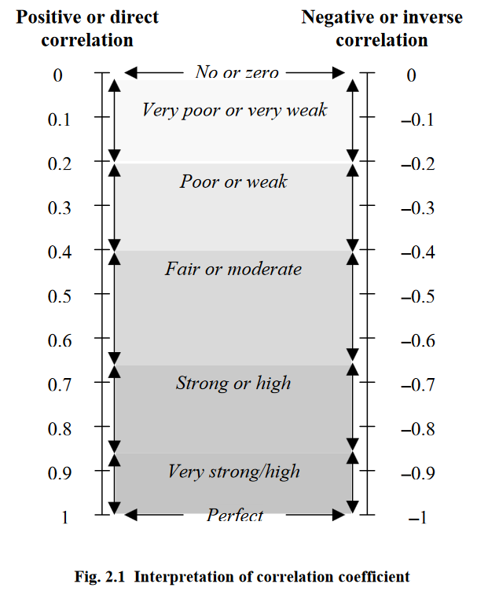
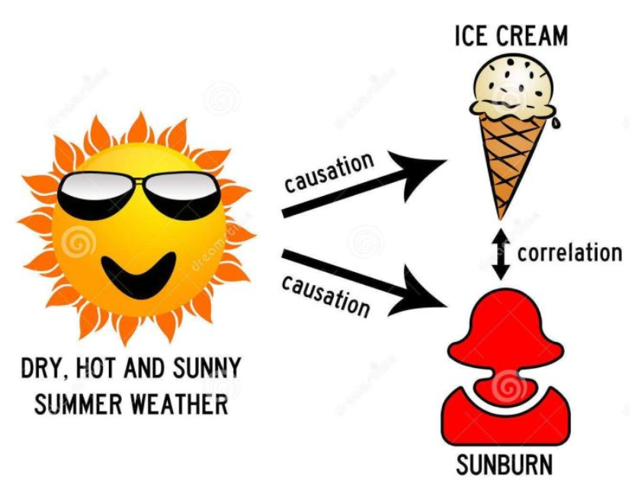
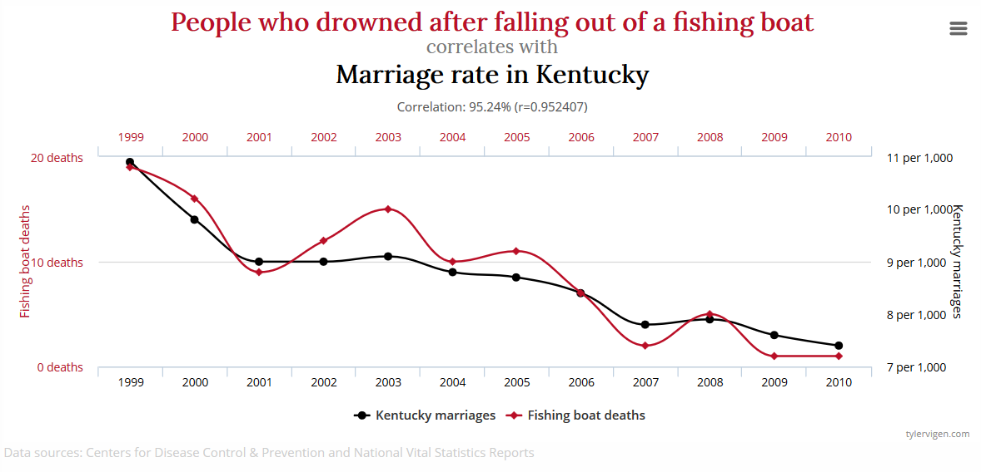
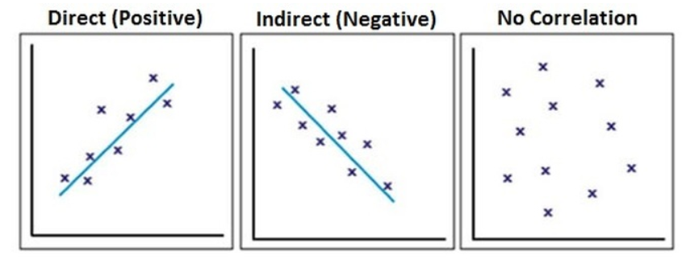
Correlation is a way to measure the relationship between variables, correlation coefficient is used to assess the strength of the association
Relationship analysis – correlation
Correlation
Correlation does not mean causation
Correlation assessment
Scatterplots
Correlation coefficient
Correlation coefficient:
R>0, positive
R=0, no linear
R<0, negative
R=±1, perfect
Significance of correlation
coefficient :
t-test is used
No correlation if
reject null hypothesis
A significant correlation does not necessarily indicate causality but rather a common linkage in a sequence of events
Spurious correlation: due to coincidence
Spurious correlation occurs between two variables that are supposed to be mutually independent
Source: Advancy analysis

Slide 12
Agenda
DIAGNOSTIC ANALYSIS
RELATIONSHIP ANALYSIS
CORRELATION ANALYSIS
ASOCIATION ANALYSIS
EXPLORATORY ANALYSIS
PREDICTIVE ANALYSIS
Sephora case study
KEY TIPS FOR DATA ANALYSIS
Appendix

Slide 13
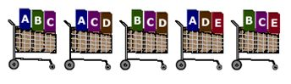
Association analysis is a method for discovering relationship between large database, e.g. market basket analysis
Relationship analysis – association analysis
What is association analysis
Decision tree example
Association analysis is widely used
Transaction basket analysis: to discover the rules that indicate the likely occurrence of an item based on the occurrences of other items in the transaction
Web usage mining: web browsing and purchase behavior
Promotion event and advertising
Association rule evaluation metrics:
Support: an indication of how frequency the itemset appears in the dataset
Confidence: an indication of how of the rule has been found to be true
Lift: the confidence of the observed support
Rule example X->Y
Support(X->Y)=support(X+Y)
Confidence(X->Y)=support(X->Y)/support(X)
Lift(X->Y)=confidence(X->Y)/support(Y)
Lift>1: the occurrence of X has a positive effect on the occurrence of Y
Lift<1: that the occurrence of X has a negative effect on the occurrence of Y
Lift=1: the occurrences of X and Y have no correlation
Rule ( X->Y) | Support (Y) | Confidence (X->Y) | Lift (X->Y)
A -> D | 3/5 | 2/3 | 5/2
C -> A | 3/5 | 2/4 | 5/6
A -> C | 4/5 | 2/3 | 5/6
B&C ->D | 3/5 | 1/3 | 5/9
Positive rule: A->D , put A and D closer in store
Negative rule: B&C ->D, do not advertise B&C and D together
Source: Advancy analysis

Slide 14
Agenda
DIAGNOSTIC ANALYSIS
RELATIONSHIP ANALYSIS
EXPLORATORY ANALYSIS
CLUSTERING
PREDICTIVE ANALYSIS
Sephora case study
KEY TIPS FOR DATA ANALYSIS
Appendix

Slide 15
Agenda
DIAGNOSTIC ANALYSIS
RELATIONSHIP ANALYSIS
EXPLORATORY ANALYSIS
CLUSTERING
PREDICTIVE ANALYSIS
Sephora case study
KEY TIPS FOR DATA ANALYSIS
Appendix

Slide 16
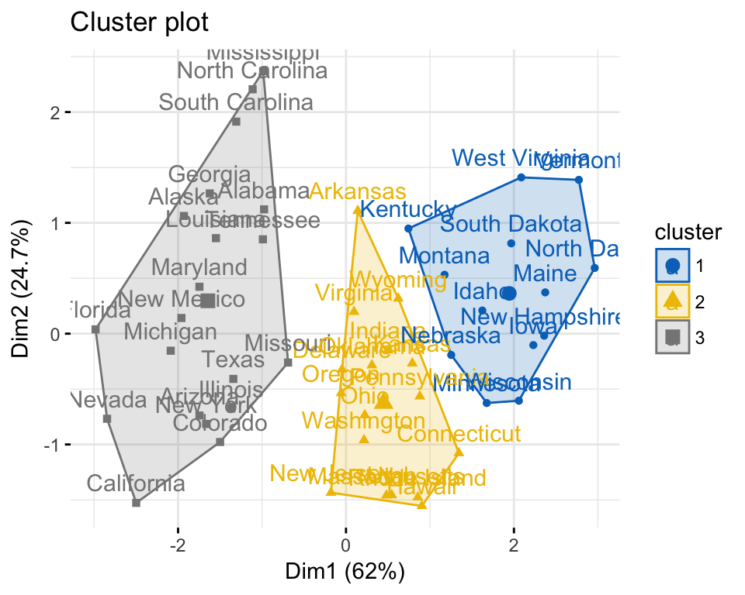
Clustering is a exploratory analysis tool, which adopts different similarity measure to place similar items into a group
Exploratory data analysis – clustering
What is cluster analysis
Cluster analysis example
Cluster analysis is used to classify objects into groups, such that:
One cluster is a group of similar objects (members, customers, stores, etc. )
Objects belonging to one cluster is different from objects belonging to other clusters
Methodologies:
Hierarchical cluster – bottom up or top down
Non hierarchical cluster – partition, density based, and others
Business application of clustering
Retail business
Customer segmentation: based on their shopping behavior, and then adopted customized marketing strategies for each group
Store segmentation: based on store characteristics, and then adopted different strategies on sales campaigns , customer acquisition and retention
Banking and insurance industry
Customer segmentation
Customer retention
Credit scoring
Non-hierarchical (K-mean) cluster for the US arrest data
Clustering criterion: based on the arrest data for each state
There groups are recognized for the US states and each group has similar behavior on arrest
Source: Advancy analysis

Slide 17
Agenda
DIAGNOSTIC ANALYSIS
RELATIONSHIP ANALYSIS
EXPLORATORY ANALYSIS
PREDICTIVE ANALYSIS
REGRESSION
TIME SERIES
CLASSIFICATION
Sephora case study
KEY TIPS FOR DATA ANALYSIS
Appendix

Slide 18
Agenda
DIAGNOSTIC ANALYSIS
RELATIONSHIP ANALYSIS
EXPLORATORY ANALYSIS
PREDICTIVE ANALYSIS
REGRESSION
TIME SERIES
CLASSIFICATION
Sephora case study
KEY TIPS FOR DATA ANALYSIS
Appendix

Slide 19
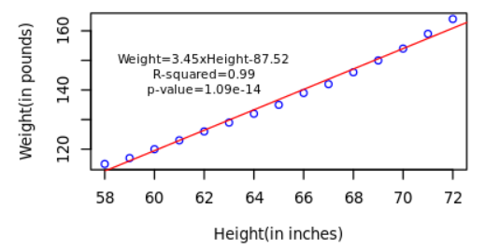
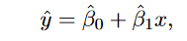
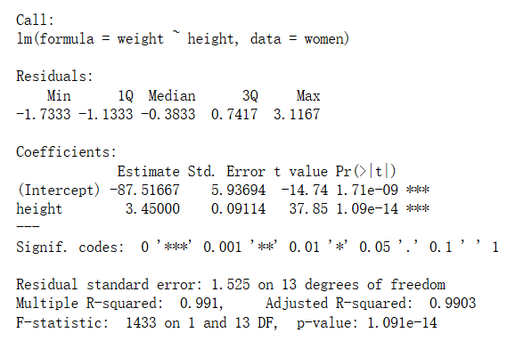
Linear regression is a linear approach to model the relationship between a scalar response and one or more explanatory variables
Predictive data analysis – linear regression
What is linear regression
Linear regression Example
Objective
Measure whether one variable is associated with another
Measure the strength of the association
Formulate an equation for prediction
Mathematical formula
: response variable
: explanatory variable(s)
: regression coefficient
: intercept
Interpretation result
Regression coefficient:
P-value: t-test
Comparison for multiple linear regression: normalization before regression
R-squared:
measure how close the data are to the fitted regression line
it is the percentage of the response variable variation that is explained by a linear model
Weight is highly correlated with height with a significant regression coefficient.
One can use height to predict the weight for somebody
Source: Advancy analysis

Slide 20
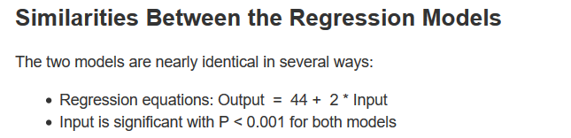
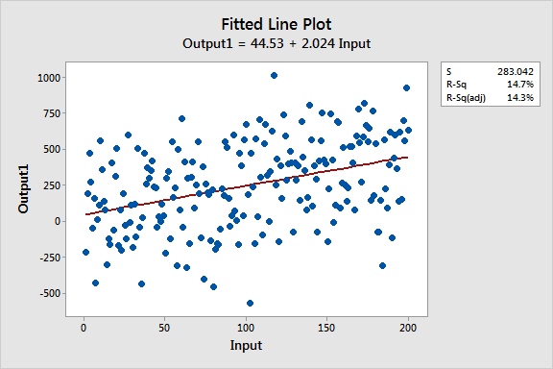
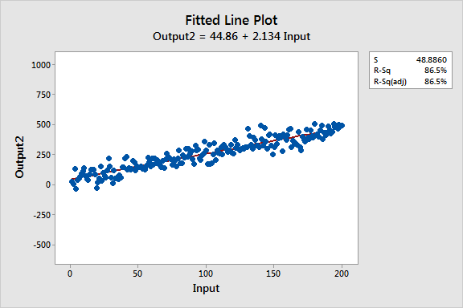
Correlation and regression are linked
Additional knowledge
Comparison of regression and regression
Low R-squared but good
Comparison | Correlation | Regression
Meaning | A statistical measure to assess co-relationship or association of two variables | Describes how an independent variable is related to the dependent variables
Usage | To represent linear relationship between two variables | To fit a best line and estimate one variable on the basis of another variable
Dependent and Independent variables | No difference | Both variables are different
Indicates | Correlation coefficient indicates the extent to which two variables move together | Regression coefficient indicates the impact of a unit change in x on y
Objective | To find a numerical value expressing the relationship between variables | To formulate an equation for prediction
If R-squared value is low but you have statistically significant predictors, you can still draw important conclusions about how changes in the predictor values are associated with changes in the response value.
A low R-squared is most problematic when you want to produce predictions that are reasonably precise
https://www.linkedin.com/pulse/regression-analysis-how-do-i-interpret-r-squared-assess-gaurhari-dass
Source: Advancy analysis

Slide 21
Agenda
DIAGNOSTIC ANALYSIS
RELATIONSHIP ANALYSIS
EXPLORATORY ANALYSIS
PREDICTIVE ANALYSIS
REGRESSION
TIME SERIES
CLASSIFICATION
Sephora case study
KEY TIPS FOR DATA ANALYSIS
Appendix

Slide 22
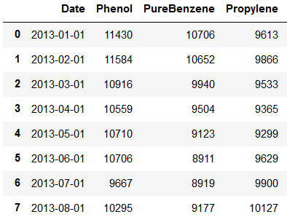
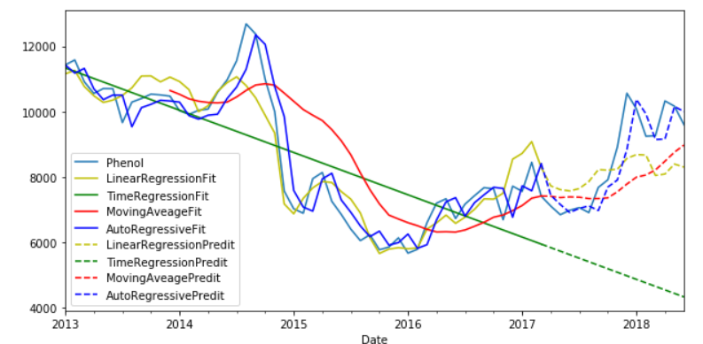
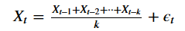
Time series is a sequence of numerical data points in successive order, describing how the variable changes over time
Predictive data analysis – time series analysis
What is time series analysis
Price forecast for phenol
Time series analysis can be useful to see how a given variable changes over time :
Time series forecasting methods produce forecasts based solely on historical values or time, while the simple linear regression is based on other explanatory variable
Time series analysis is more used in simple business or economical situation where the forecast period is short
Time series analysis is best suited to relatively stable situation
Methodologies:
Linear trend model:
Moving average model:
Autoregressive model:
Autoregressive-moving-average
Pros:
Useful when no explanatory variable is available
Easy to understand
Cons:
AR model works pool for long period prediction
MV model needs to set a reasonable lookback period
Source: Advancy analysis

Slide 23
Agenda
DIAGNOSTIC ANALYSIS
RELATIONSHIP ANALYSIS
EXPLORATORY ANALYSIS
PREDICTIVE ANALYSIS
REGRESSION
TIME SERIES
CLASSIFICATION
Sephora case study
KEY TIPS FOR DATA ANALYSIS
Appendix

Slide 24
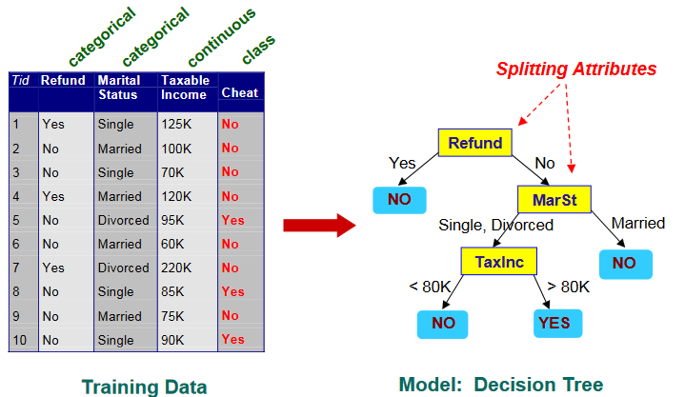
Classification is aim to predict target class for test dataset from the trained model, where the target class tags for the train data already exist
Predictive data analysis – classification
What is classification
Decision tree example
Classification is the problem of identifying to which of a set of categories a new observation belongs:
Unlike the regression analysis, the response variable is qualitative instead of qualitative
Apart from prediction, classification and clustering can link together to help pattern recognition
Methodologies:
Decision tree based
K- nearest neighbors
Others
Business application of classification
Retail business
Precision marketing: go with customer segmentation
Banking and insurance industry
Fraud detection: classify credit card transactions as legitimate or fraudulent
Risk factor identification: predict one client may default or not
Advertising and marketing
Public opinion analysis : assess the customers’ attitude based on their comments
Decision tree based classification for the cheat detection
A person who do not refund, also is single or divorced and has a taxable income above 80K is more likely to be a cheater
Source: Advancy analysis

Slide 25
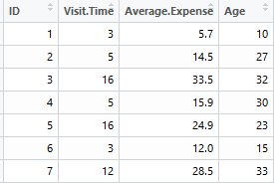
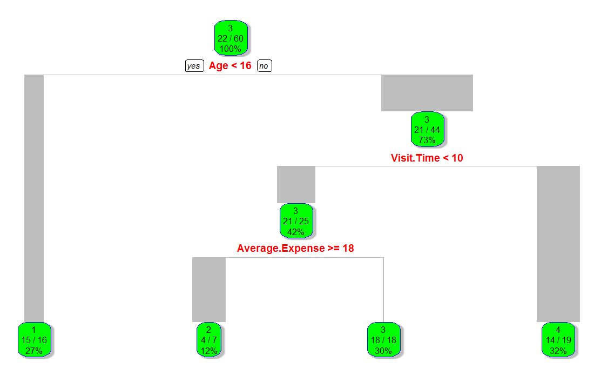
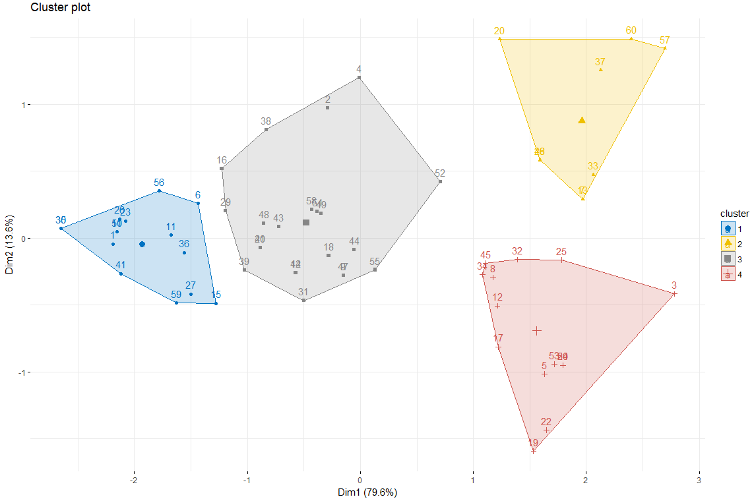
Segment customers by using clustering method and find the general character for each group with decision tree
Process of pattern recognition
Clustering & classification
Customer shopping data
(sample data)
Customer segmentation
with decision tree
1
3
Customer clustering
with K-means
2
2
summarize of pattern recognition for customer segmentation:
Step 1: customer shopping behaviour data formalization, including visit time, average spending and age
Step 2: customer segmentation into four groups with shopping behaviour data through K-means clustering
Step 3: generate classification criterion for customer group through decision tree
3
1
4
Source: Advancy analysis

Slide 26
Agenda
DIAGNOSTIC ANALYSIS
RELATIONSHIP ANALYSIS
EXPLORATORY ANALYSIS
PREDICTIVE ANALYSIS
Sephora case study
KEY TIPS FOR DATA ANALYSIS
Appendix

Slide 27
Objectives: define the best network strategy for Sephora China to optimize store performance
Case study – Sephora network background
Sephora network strategy
background
Sephora needs to strengthen its network in key cities as well as re-boost its prestige image to significantly improve performance
Current situation:
Sephora has a wide scattered network across China (~230 stores across 74 cities)
The Sephora stores in top 10 cities only represent ~50% of sales today
E-commerce is still very low (~9% of sales)
Current store segmentation is purely based on store sales and doesn’t include other key store parameters
objective
Overall channel and store performance assessment
Store key performance driver identification
Cluster current top 6 cities network based on store characteristics
analysis process
Data collection:
ticket database, member database ,store profile (physical location, BA profile, store size, etc. ), store visiting score card
Data analysis methodology:
Statistical summary for performance assessment
Correlation and hypothesis test for key driver identification
Clustering and classification for store diversification
Main result
Most Sephora stores have sales between 20 and 40 Mn and have opposite Traffic and TR
Location is the key to drive high traffic; Key drivers impacting TR are product assortment, BA service and promotional events
Store traffic and distance from nearby stores can cluster the core format stores to achieve similar member behaviors
Source: Advancy analysis

Slide 28
Sales formula is the most important KPIs in retail
Sales formula
Sales
=
traffic
X
conversion
X
AB
Most impactful driver to the performance
Determined by location
Not necessary to be luxury: some masstige locations have the best traffic
Key indicator for operation
Highly depends on BA:
BA management:
Have sufficient headcounts
Correctly allocate the BA
BA quality:
selling skill
product knowledge
service attitude
Impacted by customer profile
Indicator for cross-selling
2nd priority KPI after conversion, because emphasizing on AB might:
discourage BA for the small deals
make BA too pushy and impact customer experience
Impacted by customer profile
Source: Advancy analysis

Slide 29
Multiply data set are included for Sephora performance analysis, including fundamental store info, sales performance and filed visiting data
Case study – data filed description
BACKGROUND – data set explanation
Store fundamental info
Physical info: Opened year, store space(Sqm), distance from the nearest Sephora store, distance from downtown, city of the store
Product stock and display: number of product type and quantity of products by category or brand both in stock and display
BA profile: Total HC(headcount), traffic/HC, Sqm/HC, number(percentage) of BA for each level, change rate of BA
Store sales performance
Sales formula :Traffic, TR(Turn rate, TR=Transaction/Traffic), AB(Average basket, AB=AI*PPI)
Member profile fore each store:
Total value by card type : sales, number of purchased member and transactions
Percent of total by card type : sales, number of purchased member and transactions
Value per member by card type: sales, purchased transactions, AB
Product profile: sales by product category and brand
Store filed visit score
Store location
Store promotion
In store experience: display, environment, shopping experience, product trail, Omni channel
Post purchase: CRM
BA: beauty service, BA attitude, BA professionalism
Source: Advancy analysis

Slide 30
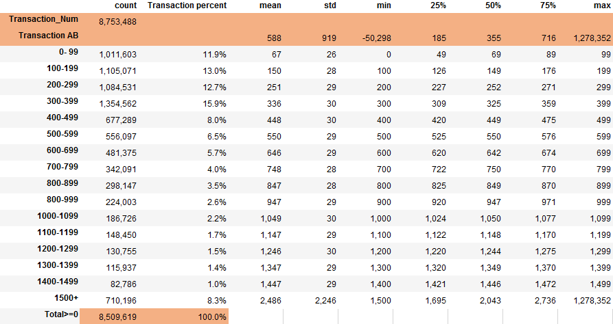
Descriptive statistics gives a quick summary of the Sephora transaction database
Statistics
Descriptive data of Sephora member transaction
Descriptive data summary of member transaction
Among the 8.5Mn positive transactions, ~90% are below 1300 AB and ~50% are below 400 AB
For the each range AB of transactions, the group 0-99 and 300-399 are quite different
0-99, more transactions are above the mean, median > mean, 25% and 75% quantiles are higher
300-399, more transactions are below the mean, median< mean, 25% and 75 quantiles are lower
Source: Sephora data, Advancy analysis

Slide 31
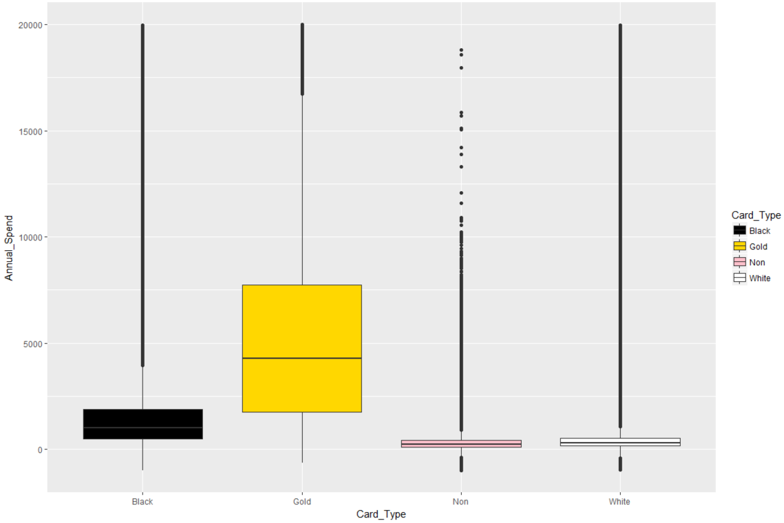
The box plot shows that there are more outliers among white and black members, which should be pay attention to when do the member analysis
Statistics
Box plot of Sephora member info
Annual spend by card type
Outlier
In terms of the annual spend for each card type
There are significant level of outliers among white and black members
The gold and black members are more likely to purchase more as (Q3-Q2> Q2-Q1)
some outliers of the white or black members are company employees, which should be removed for member analysis
Source: Sephora data, Advancy analysis

Slide 32
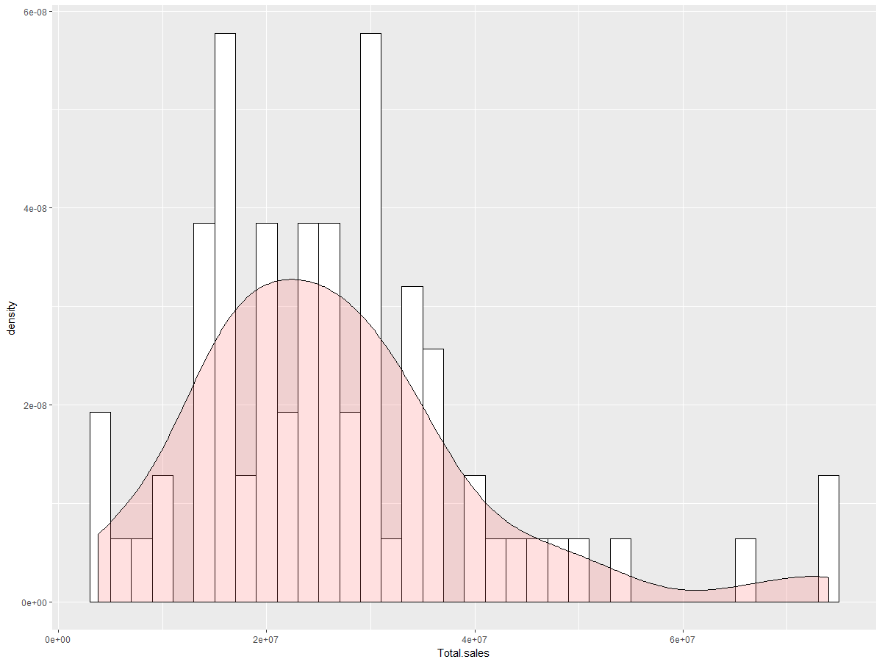
The positive skewness of Sephora store sales shows that some stores are highly outperforming in the right tail
Statistics
Density plot of Sephora store sales
Density plot of yearly sales per store
Positive Skewness
Positive Kurtosis
Positive skewness: from the distribution of total sales per Sephora stores,
Most stores are in the similar performance level, with 4-46Mn RBM sales
Some are highly outperforming. It might be interesting to deep dive the stores in the right tails.
Source: Sephora data, Advancy analysis

Slide 33
Guangzhou has the best performance driven by TR and AB level; performance are comparable across cities apart from Hangzhou’s abnormal high traffic
Statistics
Case study – statistical summary for city performance
Avg. per store performance by city | Full Year 2017, comparable stores, average per store performance
Avg. Sales | Mn rmb
Avg. Traffic |k visits
=
x
TR | % conversion
x
aB | RMB spent per TICKET
Guangzhou: outperforms with good traffic, highest conversion and AB, mainly because of its location advantage
Guangzhou
50
380
19%
681
3 stores
+105%
+23%
Hangzhou: highest traffic and lowest TR, due to people going through the stores to enter mall
Hangzhou
32
574
9%
580
4 stores
Beijing: particularly low basket value, mainly due to low AI
Beijing
29
339
16%
552
25 stores
+98%
+157%
Shanghai: low in-store traffic
Shanghai
28
240
17%
672
22 stores
Shenzhen: particularly low in-store traffic as no store in key commercial area
Shenzhen
26
223
18%
657
3 stores
Chengdu: below avg. on every factors, partially impacted by landlord’s ongoing renovation
Chengdu
25
278
16%
586
6 stores
6 cities average
What drives outperformance of some cities, despite of cities’ particularities?
Ø 29.5
Ø 309
Ø 16%
Ø 606
Best performance
Lowest performance
Source: Sephora data, Advancy analysis

Slide 34
Most Sephora store have annual sales in the 20-40 Mn RMB range, with typically opposite Traffic and TR behaviors
Statistics
Case study– Traffic vs TR visualization
Store performance mapping: TR vs Traffic | MN RMB, K visits, %, comparable stores, 2017
TR
Avg.: 313k visits
9 Top performers: 40 Mn and above
Avg.: 16%
~65% of Sephora stores sales are between 20 and 40 Mn
Most of the stores have the same sales formula characteristics and cannot be differentiated
Ventre-mou: average stores
39 stores:
20-40 Mn
0
100
200
300
400
500
600
700
800
900
1,000
Traffic (k visits / year)
Size of bubble = sales
Annual sales (Mn RMB)
60 and above: 3 stores
20-40: 39 stores
40-60: 6 stores
0-20: 14 stores
Source: Sephora data, Advancy analysis

Slide 35
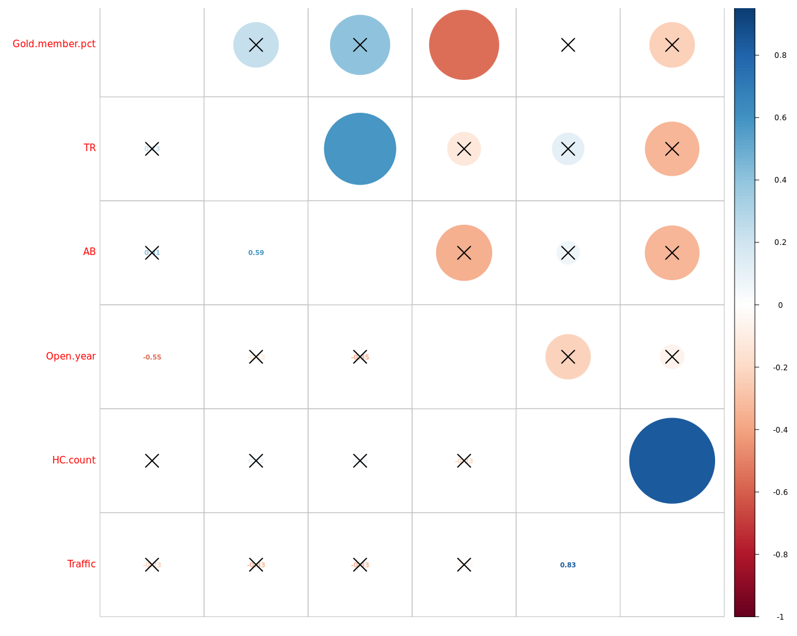
Correlation matrix is used to analyze the correlation between multiple variables at the same time
Correlation
Case study – multi variables correlation matrix
Correlation matrix
#Gold%
TR
AB
Open year
# HC
TRAFFIC
#Gold%
1
TR
Positive correlation
TR and AB
HC count and Traffic
Negative correlation
Gold member percentage and Open year
Significance of correlation coefficient is low
The pairs with X mark
AB
Open year
# HC
TRAFFIC
-1
Correlation coefficient
Source: Sephora data, Advancy analysis

Slide 36
The hypothesis test result verifies the assumption that TR is effected by the promotion event
Hypothesis test
Case study – hypothesis test
TR key driver – promotion event
Store TR
Hypothesis test
Two independent-sample test for TR
Null hypothesis
The TR is the same for the different day type
Conclusion
It should reject the null hypothesis of the same TR for the most of the day type pair apart from the following three
Normal festival & normal weekend
Normal weekday & Promotion weekday
Promotion weekend & promotion Festival
TR is highly influenced by promotion event
T-test p-value
Source: Sephora data, Advancy analysis

Slide 37
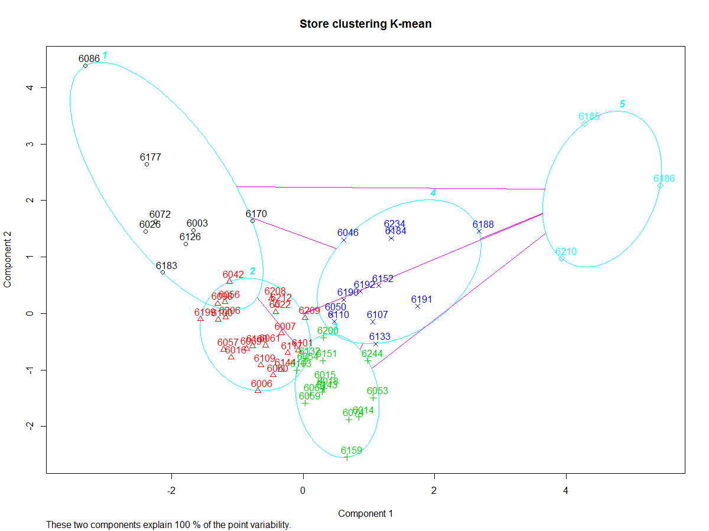
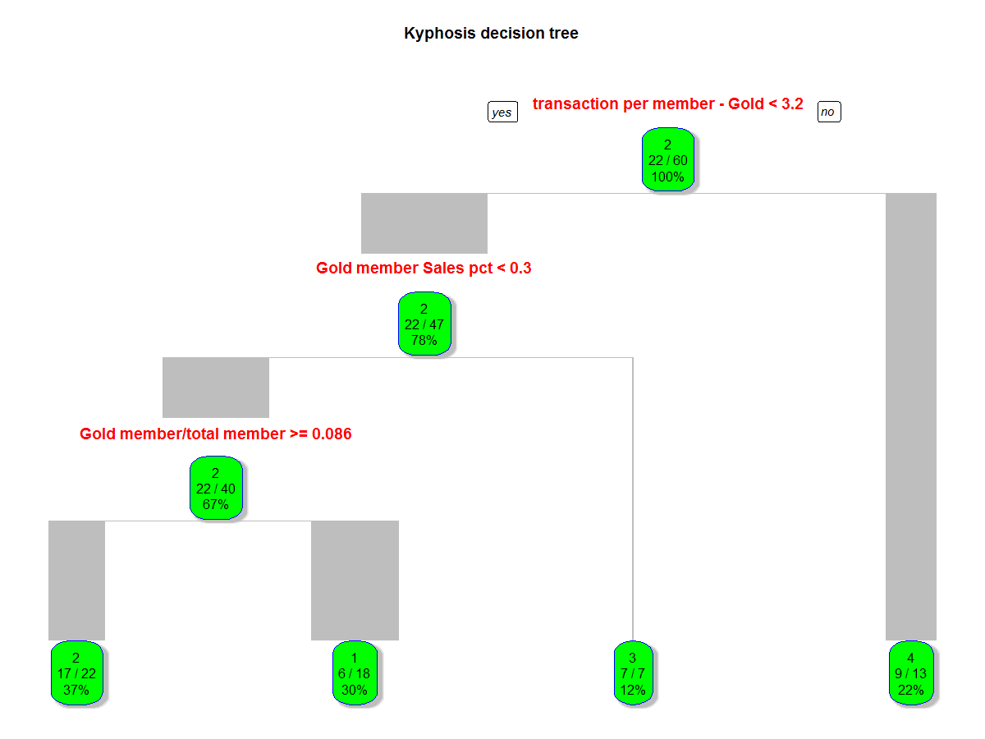
Further clustered the core format stores to achieve similar member behaviors: differentiation comes from store traffic and distance from nearby stores
Clustering
Case study – clustering and classification
BACKGROUND – Sephora network strategy
1
5
4
Group number | Average distance | Average of Traffic
1 | 2.69 | 568,919
2 | 2.02 | 310,551
3 | 3.28 | 172,703
4 | 8.65 | 275,488
5 | 21.10 | 218,185
2
3
Clustering : using K-means through store traffic and distance from the nearest store.
1: High traffic, downtown
2: Average traffic, downtown
3: Low traffic, downtown
4: Average traffic, residential
5: Low traffic, residential
Classification: The decision tree shows that member behaviors are different from group to group
1: low purchase frequency, low gold sales pct., high white member pct.
2: low purchase frequency, low gold sales percent, high gold member pct.
3: low purchase frequency, high gold sales pct.
4: High purchase frequency
Source: Sephora data, Advancy analysis

Slide 38
Agenda
DIAGNOSTIC ANALYSIS
RELATIONSHIP ANALYSIS
EXPLORATORY ANALYSIS
PREDICTIVE ANALYSIS
Sephora case study
KEY TIPS FOR DATA ANALYSIS
Appendix

Slide 39
Examples and tips throughout the whole analysis process for future data analysis project
Key tips for data analysis
Analysis process | Key topics | Detail examples and tips
Data collection | Internal data calibration External data gathering | Set the data scope beforehand and ensure the completeness of dataset : Make a data request template for client’s internal CRM team Check the data to ensure that we are on the same page with clients Try to gather external data that relevant to analysis Web spider for dianping.com comments Baidu map API for Sephora stores’ geographical info
Data cleaning | Missing and error data Dataset formalization | Fill or drop the missing and error data: Fill the member card type as white for members with no info Drop the two stores with inaccurate traffic data for comparable store analysis Formalize basic database for further analysis : Combine multiple data sources together and make a detailed but accessible database
Data mining and draw conclusion | Hypothesis testing Data exploration | Hypothesis driven test: Use data comparison for with & w/o event to prove promotion influence Data exploration for unobvious features and relation Deep dive member’s shopping behavior by tracking its total two years’ transactions Segment store type by statistical learning methods, K-means, decision tree
Result explanation and visualization | Business driven result Data Visualization | Try to make the model and analysis simple and reasonable: Mathematical methods can give clues for result when no general methodologies are available but a simple way is then needed for result explanation Use data visualization tool to better show result Make a web tool for data visualization, incl. city map, scatter plot and correlation test http://47.98.102.15:3838/Advancy/Sephora-case example/
Source: Advancy analysis

Slide 40
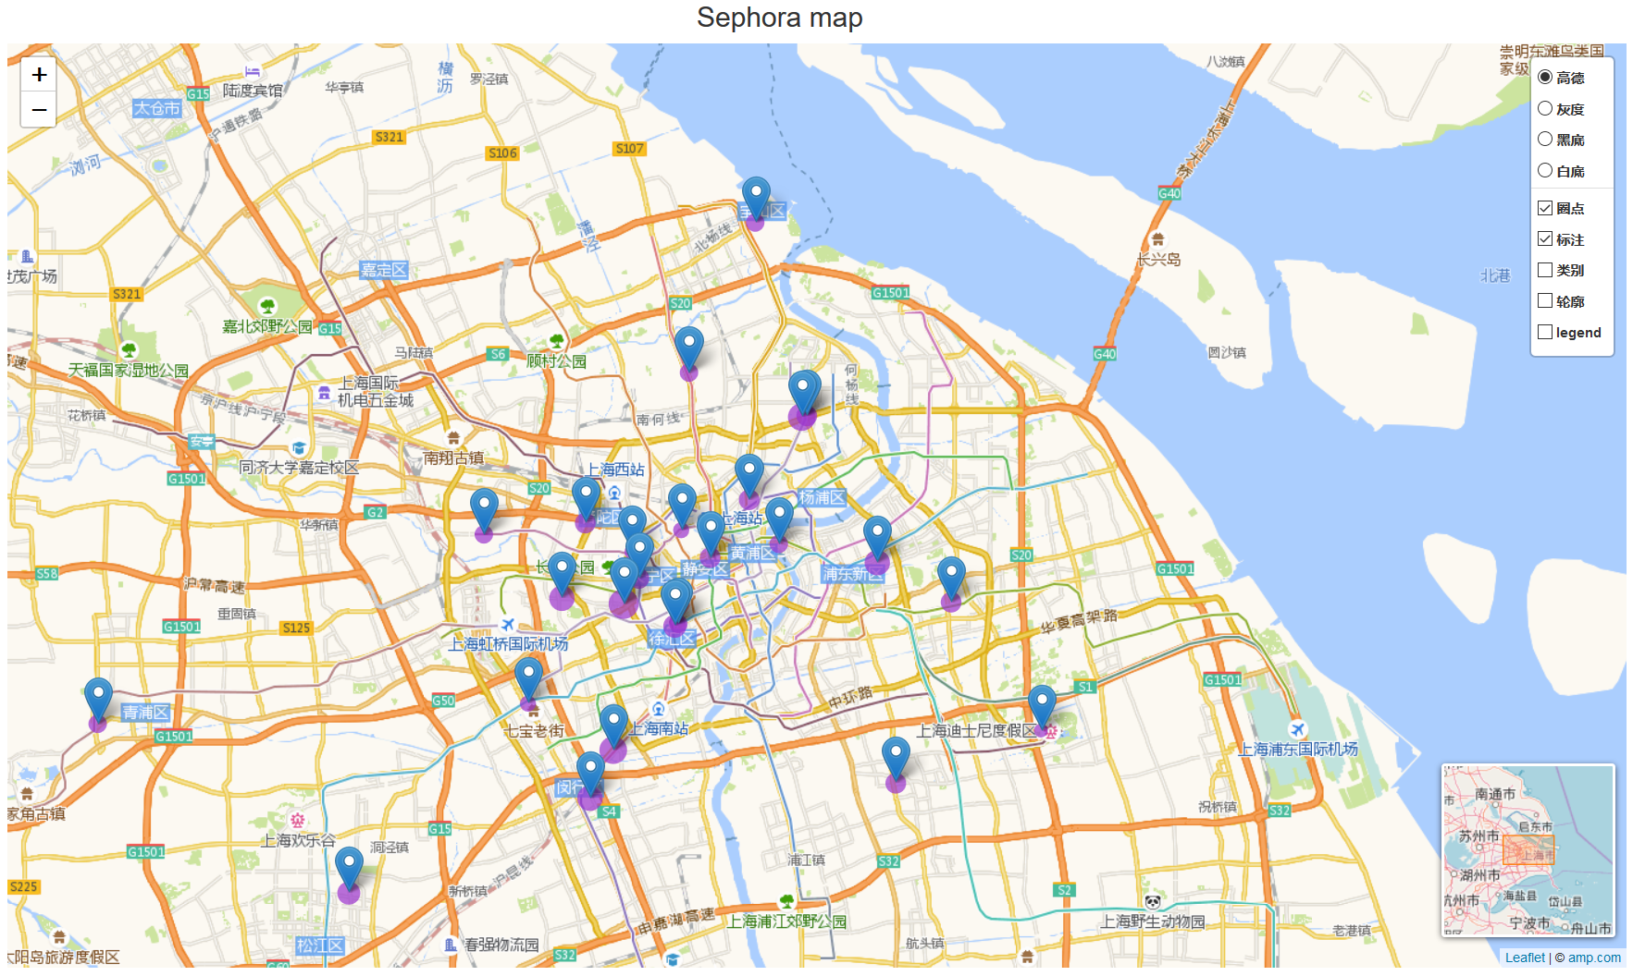
Use data visualization tool can be a better way to help for analysis and show the result
Sephora KPI value map
Data Visualization of TR for SHANGHAI SEPHORA STOR
Graph explanation
Each point stands for a Sephora store
The point size stands for the TR value for each store
TR rate comparison
TR rate is low in downtown stores
Some stores near downtown have high TR rate
Source: Sephora data, Advancy analysis

Slide 41
Agenda
DIAGNOSTIC ANALYSIS
RELATIONSHIP ANALYSIS
EXPLORATORY ANALYSIS
PREDICTIVE ANALYSIS
Sephora case study
KEY TIPS FOR DATA ANALYSIS
Appendix

Slide 42

Appendix

Slide 43
disclaimer
This presentation has been prepared for xxx by Advancy on the understanding that it will be used for internal purposes only, and that it will neither be distributed to the public nor referred to in any public document without the prior written approval of Advancy.
In compiling the presentation, Advancy has relied upon various public information sources as well as management interviews and internal analysis and estimates. We have not sought to independently verify all such information.
Analyses and projections represent Advancy Consulting’s judgment, based upon data sources cited, and are subject to the validity of the assumptions noted herein. No access to customers has been granted at this stage, making some of the forecasts less reliable.
Whilst reasonable care has been taken to confirm the reliability of the information and opinions expressed herein, no warranty is made as to the accuracy or completeness of this document. All estimates and projections contained in this report are based on data obtained from the sources cited and involve significant elements of subjective judgment and analysis, which may or may not be correct.

Slide 44
上海市徐家汇路610号日月光中心31楼 邮编200025
31F, SML Center
610 Xujiahui Road, Shanghai 200025
Tel: +86 21 6386 7033
www.advancy.com
Shanghai – Boston – Düsseldorf – London – Munich – Paris – São Paulo – Sydney

